Slide 1
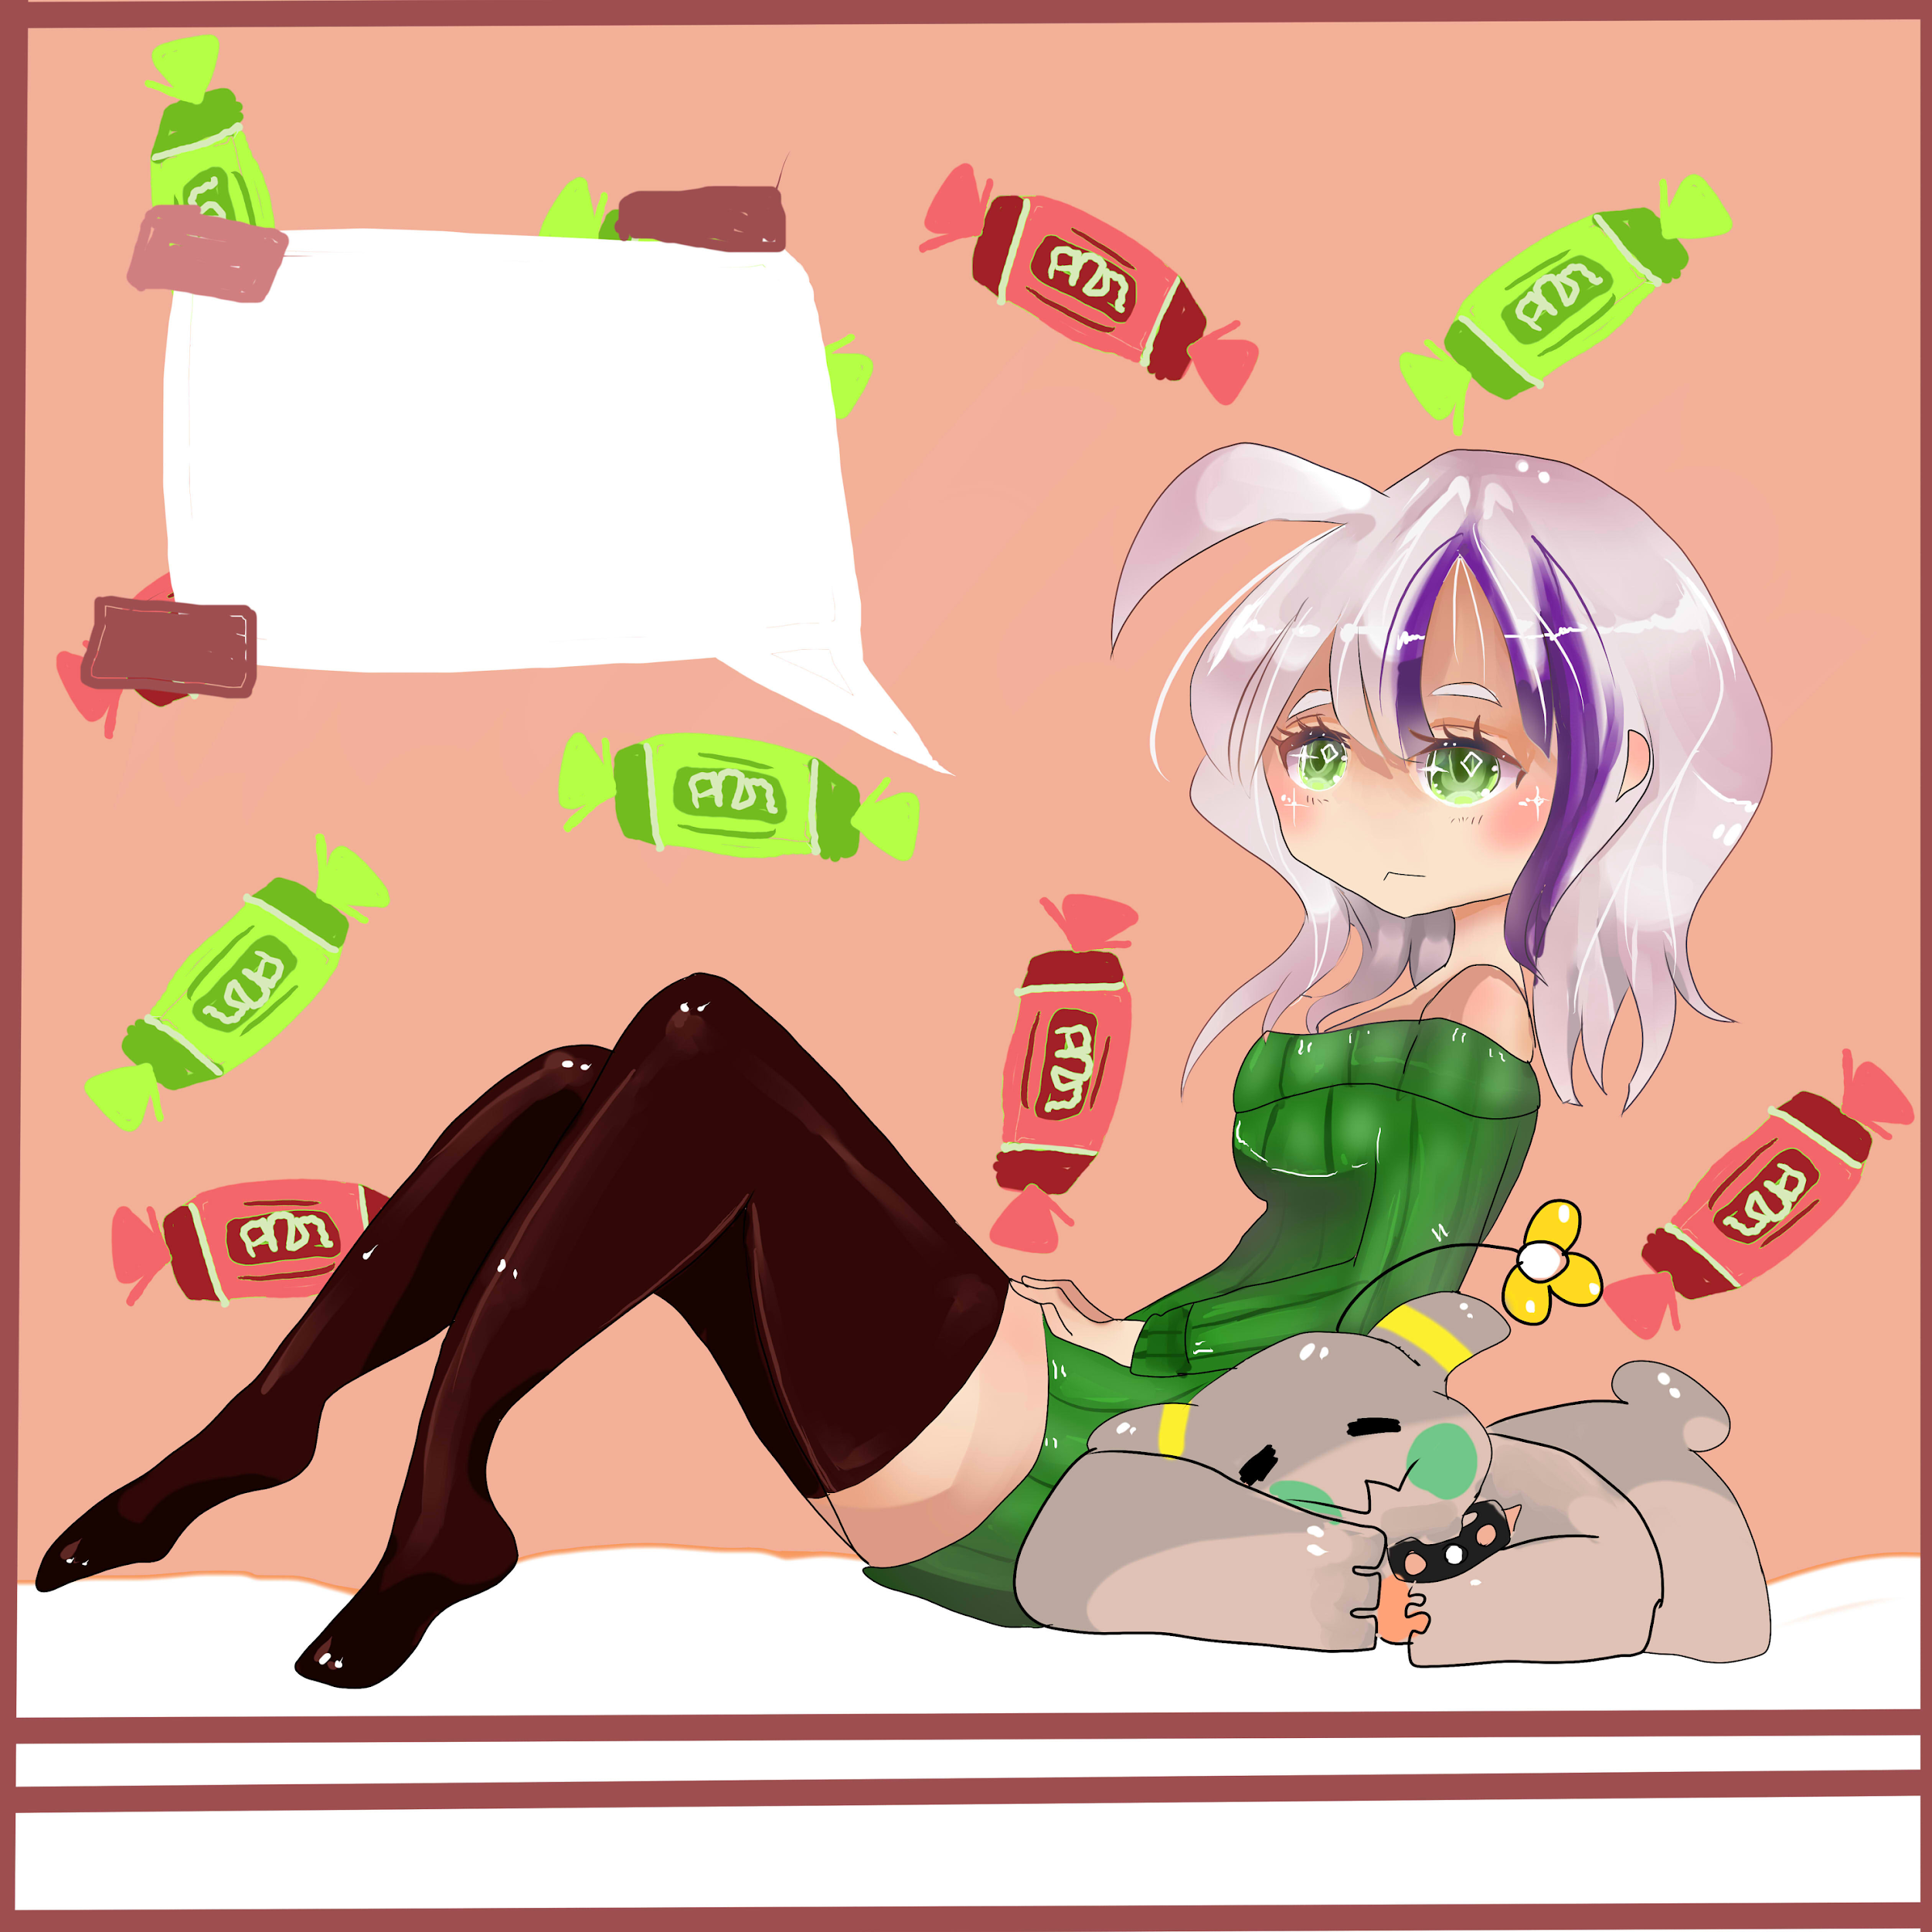
LIFE AND DEATH
CHOICES MATTER, BUT DO YOU?
Pen And Paper Studios:
Jaden Feliciano and Kayla Deer

Slide 2
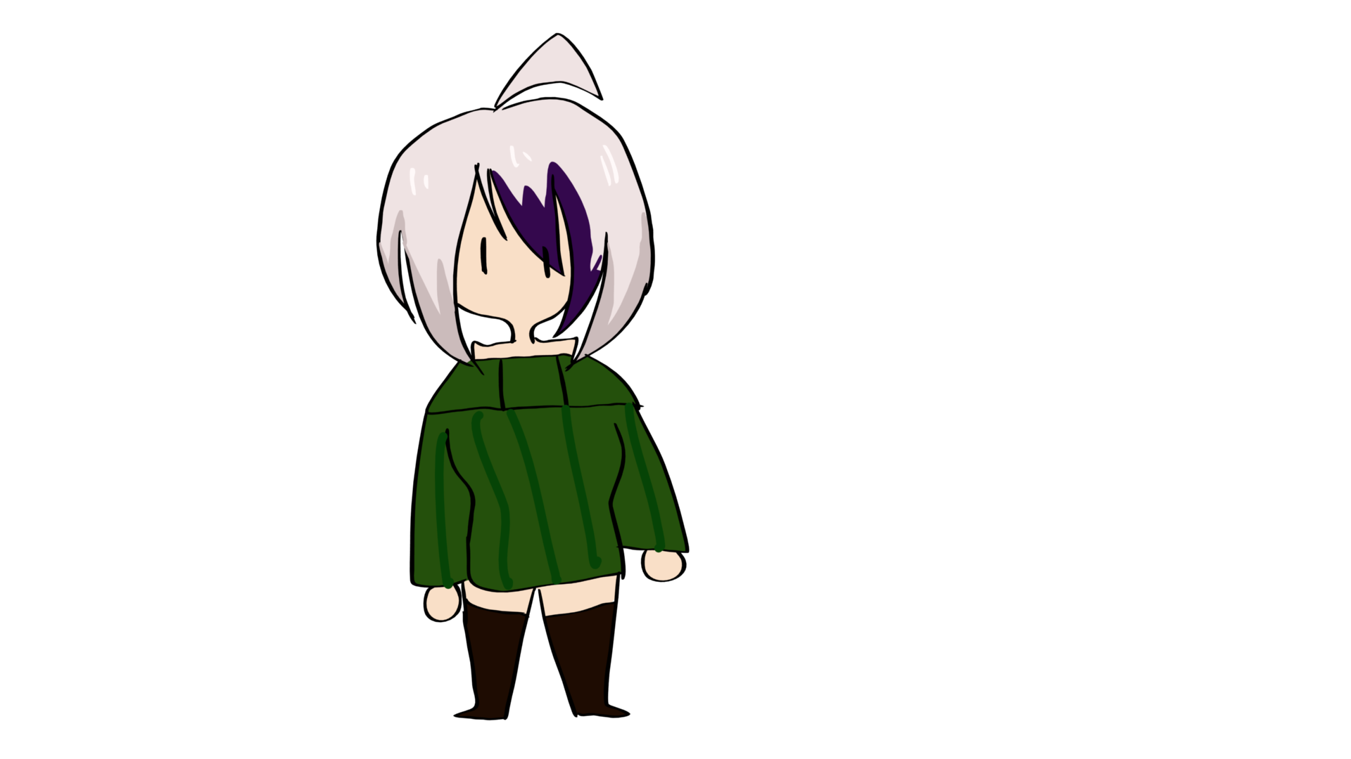
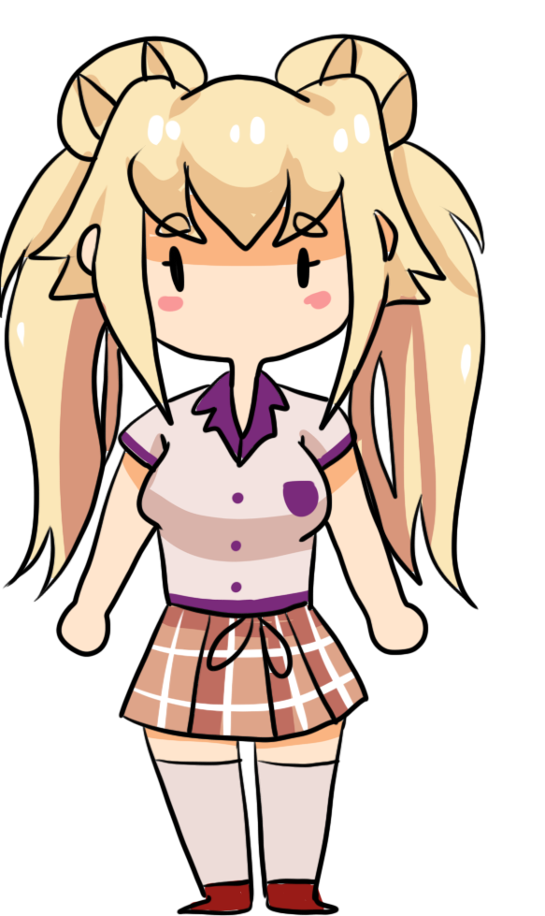
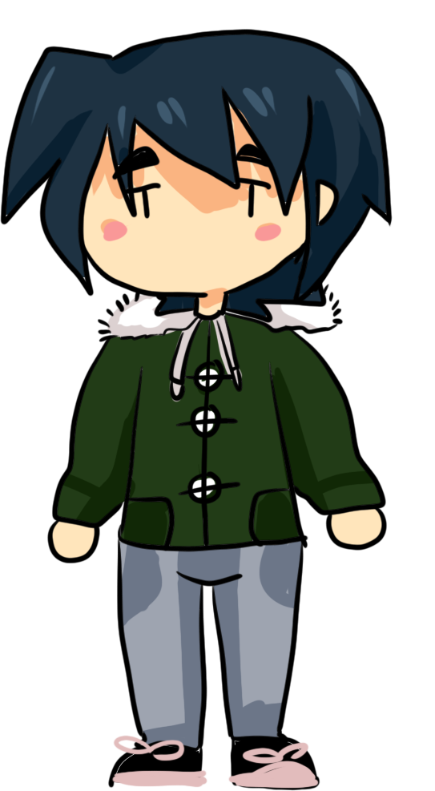
PEN AND PAPER STUDIOS
Pen and Paper Studios was founded just a few weeks ago, by a very skilled programmer, and very talented artist.
Jaden and Kayla, a hard working duo, of which we put our blood sweat and tears into our first ever game.
About Us

Slide 3
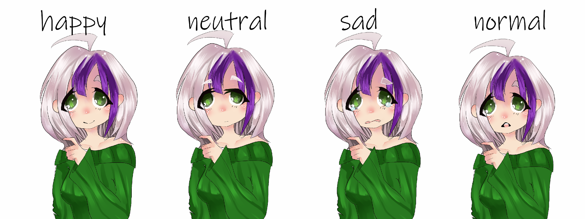
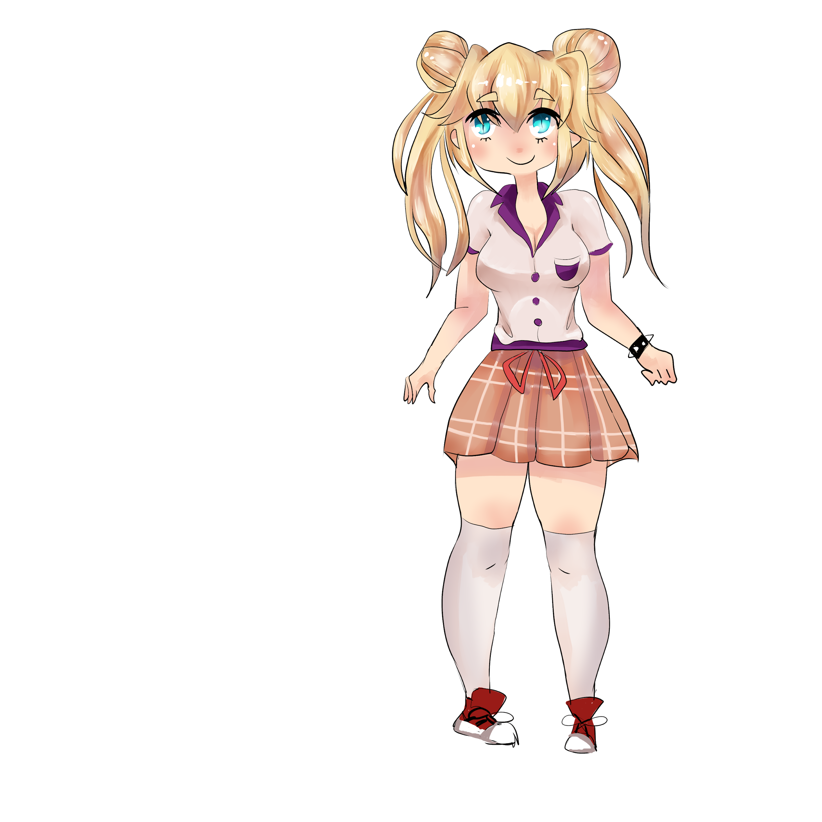
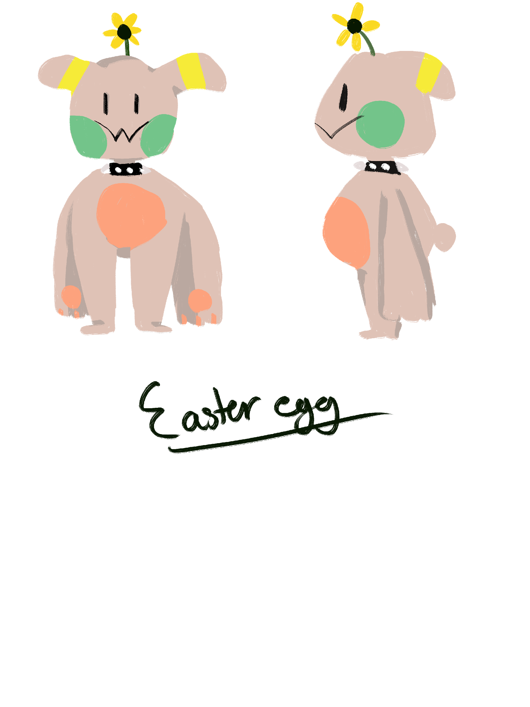
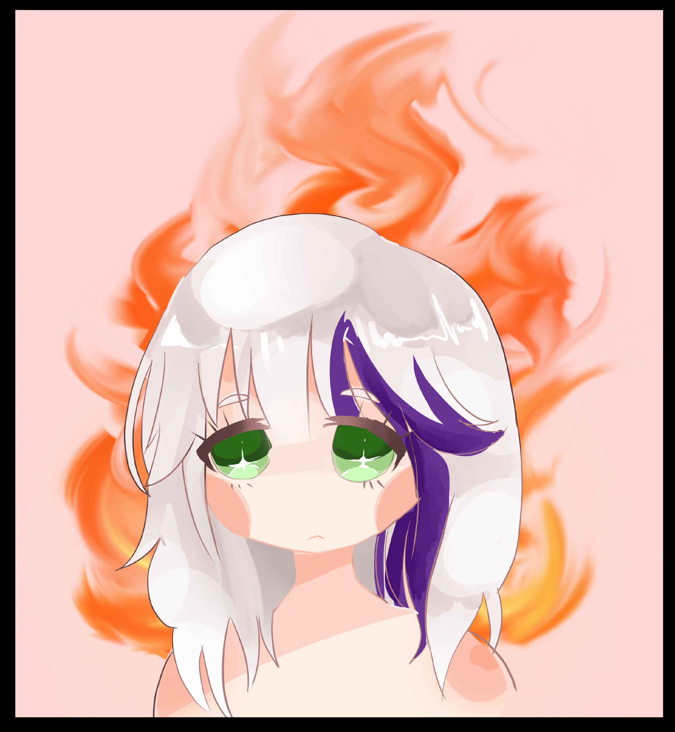
OUR PROMISE
We’ve made it our mission to provide you with a character of relatability to all players around the world. You’ll want cry for her, do what’s best for her, and give your all to succeed in the goal of a lifetime. Live, or die.

Slide 4
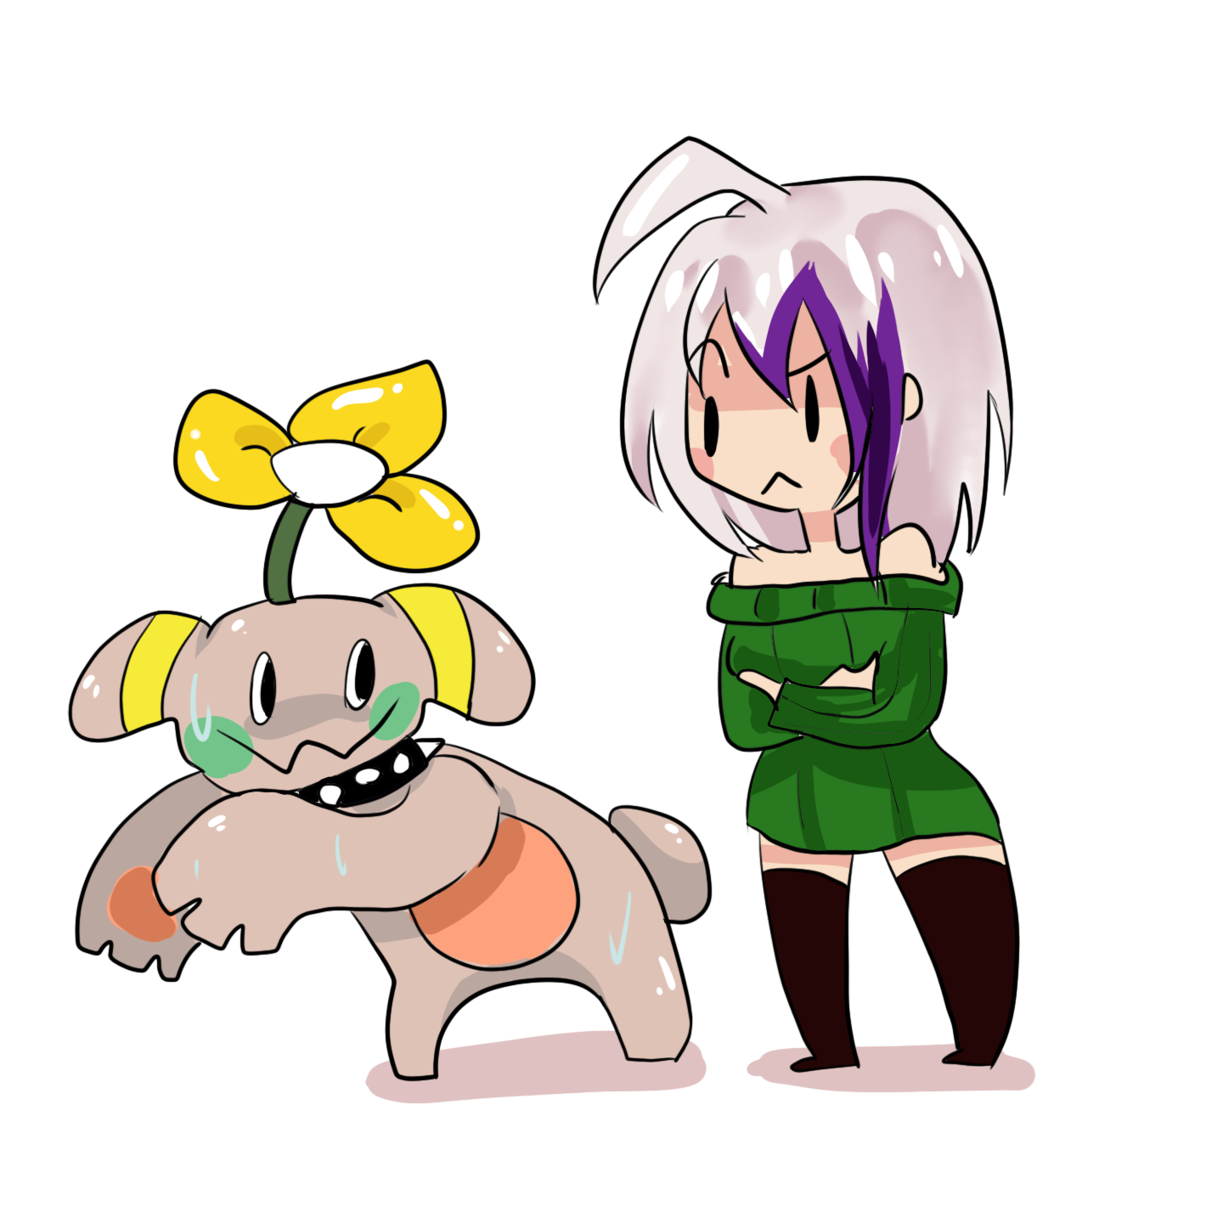
THE STORY
Each choice you make reflects how Mayu acts during the game. So most players will make it so that you'd want to make the best possible choice for her, sometimes not knowing which would be the better one. As well as the fact that you’d want to see how the story plays out as you go on. Mayu will inevitably succumb to a life changing decision.
A creature very critical to the story will present itself. Throughout the game, you can make different choices, in which the outcome will change the game depending on what you choose.

Slide 5
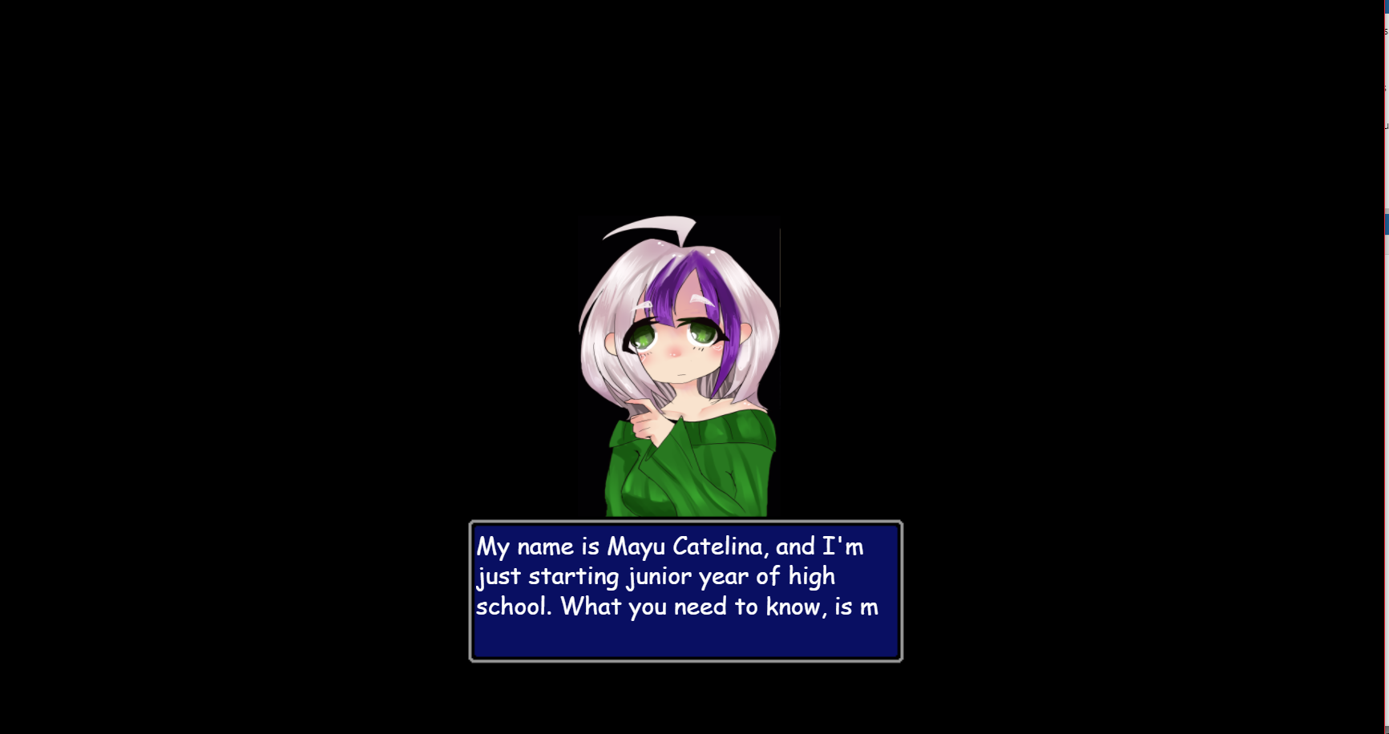
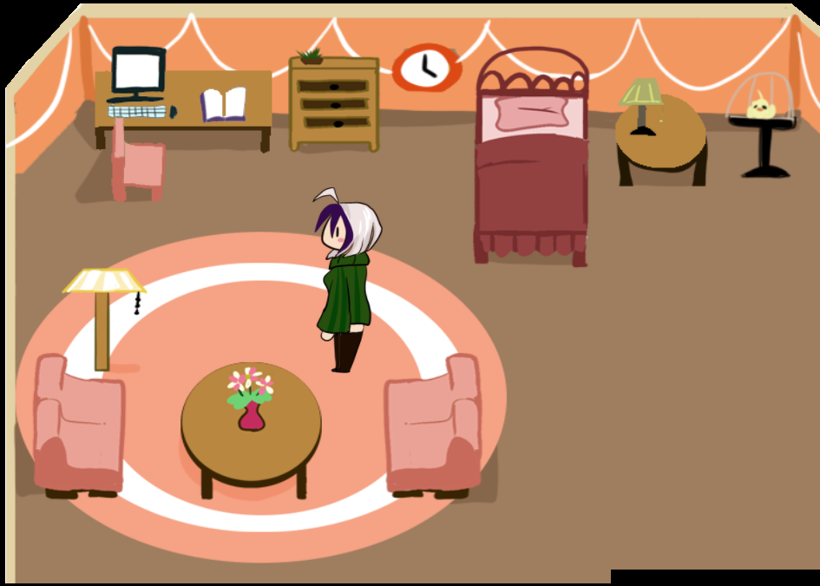
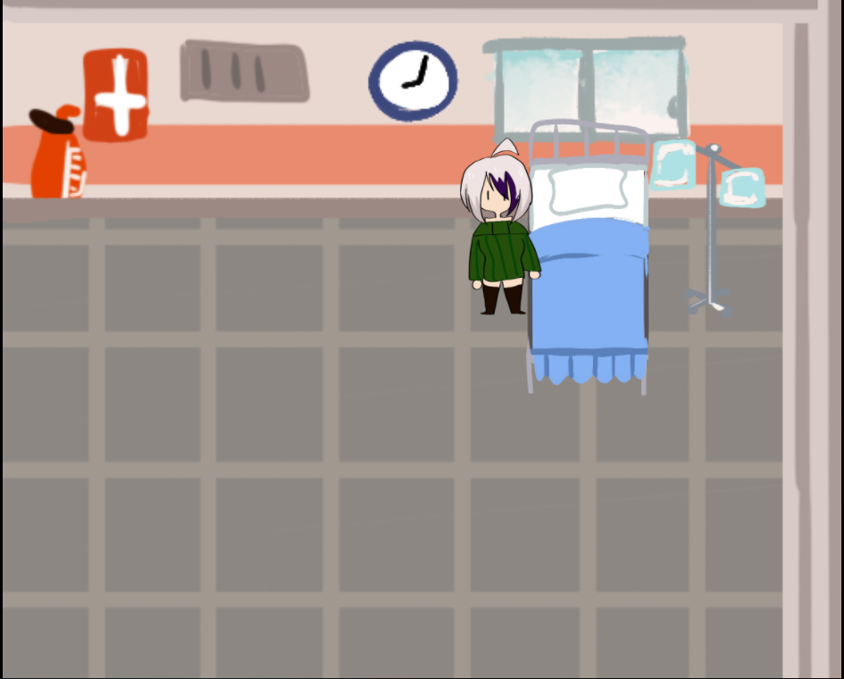
OUR PRODUCT
We are currently in a beta build of our game. What’s in the beta?
Well…..
Text box use as the first cut scene
Full animation for the 4 direction movement
World Map layout to move from map to map(Home, Hospital, School Grounds)
And much more!
Currently, the school grounds map is under development. There are still some bugs to tweak with the text boxes as well. In the next patch, these problems should be dealt with.

Slide 6
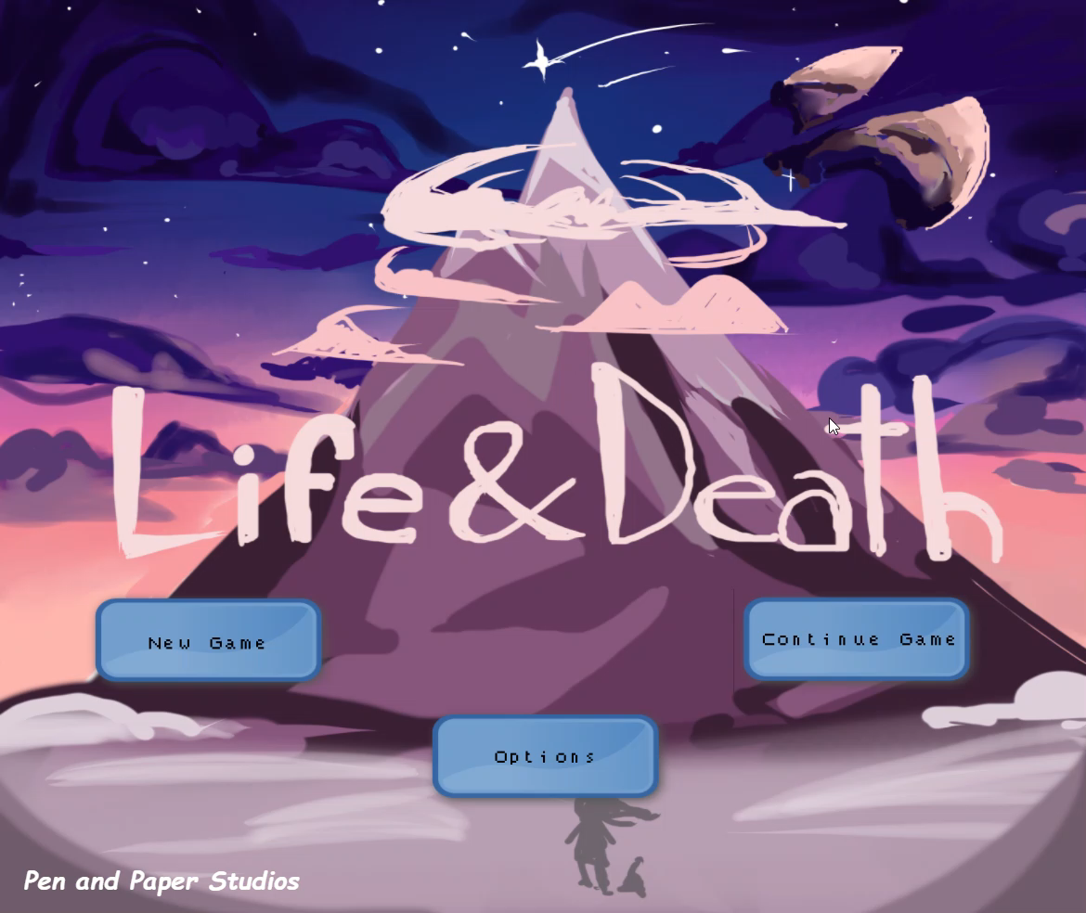
BETA BUILD

Slide 7
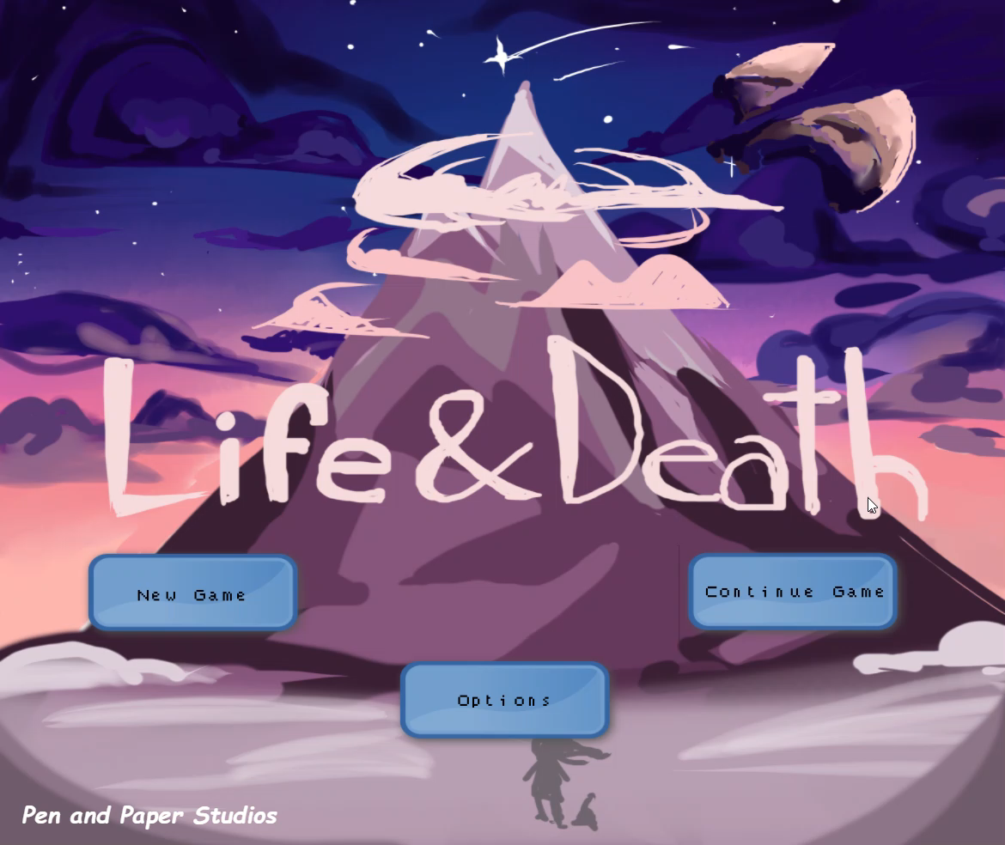
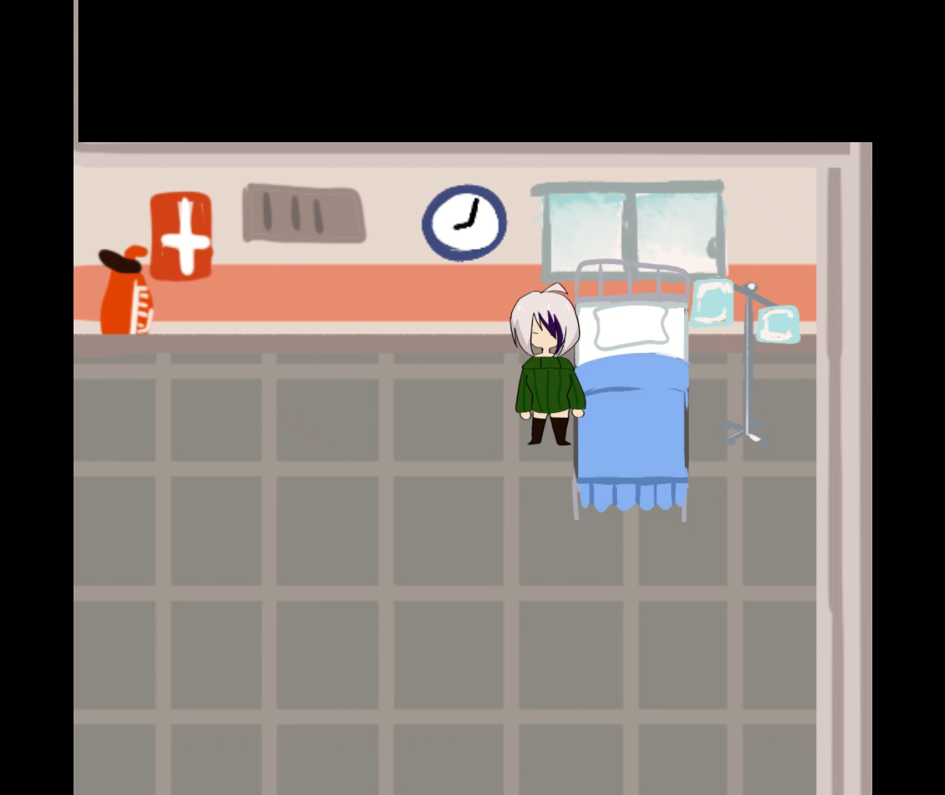
WORKS IN PROGRESS
Options Menu (Brightness and Music settings don’t work yet.)
Cut scene before leaving the hospital (Was kept out of the Beta video).

